Slide 1
Project 2 and BB
I will grade your Project 2 as soon as I can.
Blackboard ‘weighted sums’

Slide 2
Final Exam Schedule
MONDAY – WEDNESDAY
Class Time | Exam Date | Exam Time
7:30 am – 10:10 am | Mon. 12/14 | 7:30 am – 10:15 am
7:30 am – 8:45 am | Wed. 12/9 | 7:30 am – 10:15 am
9:00 am – 10:15 am | Mon. 12/14 | 7:30 am – 10:15 am
10:30 am – 1:10 pm | Mon. 12/14 | 10:30 am – 1:15 pm
10:30 am – 11:45 am | Wed. 12/9 | 10:30 am – 1:15 pm
12:00 pm – 1:15 pm | Mon. 12/14 | 10:30 am – 1:15 pm
1:30 pm – 4:10 pm | Mon. 12/14 | 1:30 pm – 4:15 pm
1:30 pm – 2:45 pm | Wed. 12/9 | 1:30 pm – 4:15 pm
3:00 pm – 4:15 pm | Mon. 12/14 | 1:30 pm – 4:15 pm
4:30 pm – 7:10 pm | Mon. 12/14 | 4:30 pm – 7:15 pm
4:30 pm – 5:45 pm | Wed. 12/9 | 4:30 pm – 7:15 pm
5:55 pm – 7:10 pm | Mon. 12/14 | 4:30 pm – 7:15 pm
7:20 pm – 10:00 pm | Mon. 12/14 | 7:30 pm – 10:15 pm
7:20 pm – 8:35 pm | Wed. 12/9 | 7:30 pm – 10:15 pm
8:45 pm – 10:00 pm | Mon. 12/14 | 7:30 pm – 10:15 pm

Slide 3
Final Exam – 100 minutes – in class on BB 25 Questions (2 questions have 2 parts) - Multiple Choice or True/False Open Book – formula sheet provided Use Excel – calculations only – no graphics
Topic | # Questions | # points
Calculate Probability (including Conditional) | 2 | 8
Calculate Z-Scores | 1 | 4
When can we use a ‘normal’ approximation (rules of thumb) | 2 | 8
Calculate Expected Value | 1 | 4
Sampling (random, biased, convenience, …) | 1 | 4
Distributions (Binomial, Normal, Student’s t) | 2 | 8
Confidence Intervals | 1 | 4
Margins of Error | 1 | 4
Significance tests | 2 | 8
Variable types | 1 | 4
Interpreting results (statistical and in problem terms) | 1 | 4
Comparing Two Groups | 1 | 6
Using Regression Analysis | 3 | 12
Generating Random Samples | 1 | 4
Comparing Player and Team Performances | 4 | 16
Verification of compliance with the Honor Code | 1 | 2

Slide 4
Chapter 1 Student Learning Objectives
Read the GMU Honor Code and certify that you will adhere to it.
Exam Question
Understand why it is often necessary to filter out the noise to see the underlying relationships.
Not considering players with minimal (or no) attempts, etc.
Not considering ‘injury years’ in McGwire Hypothesis Analysis
Understand the inherent randomness of data and how analytics methods are designed to extract useful information in the presence of this randomness.
We asked what is the ‘true’ probability, average, proportion and used confidence intervals to look at this.
Creating ‘random samples’ and using sampling distributions and the CLT
Recognize that when using statistical models of any type, it is important to keep in mind that they involve some idealization and simplification of complicated physical relationships.
Assumptions in building our computational models (e.g., WHIP represents a pitcher’s control)
Hit-by-pitch reflects a batter’s reflexes (as they grow older)

Slide 5
Chapter 1 Student Learning Objectives
11. Recognize that the random nature of sports is one of the primary contributions of analytic methods, such as those used in sabermetrics, to the analysis of sports data.
If we could repeat Jamal Charles’ rushing stats for a year, they would not be exactly the same
One-year confidence intervals were good predictors of ‘true ability’ but not exact
Kevin Durant PPG Average for career
Joe Flacco (Quarterback) Rating for career
NFL (Quarterback) Ratings for careers
12. Understand the difference between data and information.
Explaining our conclusions in terms of both statistics and in terms of the problem context
Using the Agresti apps to produce graphics
13. Be able to access internet sites to retrieve data for analysis, especially those related to sports-reference.com.
Also, WTA, Fangraphs, ESPN, Baseballguru.com etc.
14. Understand how to access Excel and its statistical (and other) functions. Also StatCrunch and the Agresti apps.

Slide 6
Chapter 2 Student Learning Objectives
Know how to Summarize Results by a Single Number: Mean and Median
Tom Brady’s passing yards per game
Jamal Charles’ rushing yards per attempt
Using Excel and/or StatCrunch
Understand why and how to Measure the Variation in Sports Data
Variance, standard deviation, margins of error, confidence intervals
Recognize and Measure the Variation in a Qualitative Variable Such as Pitch Type
Entropy of NL pitchers’ pitches – Clayton Kershaw
Know why we Use Transformations to Improve Measures of Team and Player Performance
Quarterback Ratings, WAR – Mike Trout
Learn and use the Computational capabilities of Excel and StatCrunch and the Agresti apps as needed.

Slide 7
Chapter 3 Student Learning Objectives
Apply the Rules of Probability to Sports
Conditional Probability (Jake Cutter’s interception analysis)
Simson’s Paradox (Derek Jeter batting average analysis)
Model the Results of Sporting Events as Random Variables
Yankees Season Wins (1 = win, 0 = loss)
Quarterbacks’ completions (or not)
Free Throw percentages (1 = made it, 0 = missed it)
Pitchers’ Win percentages (e.g., Porcello performance with Tigers and red Sox)
Summarize the Distribution of a Point Distributions and Expected Points
Montreal Canadians ‘Hockey Points’ Analysis
Learn how to Tailor Probability Calculations to Specific Scenarios: Conditional Probability
Chicago Bears and Green Bay Packers
Relate Unconditional and Conditional Probabilities: The Law of Total Probability
THE IMPORTANCE OF SCORING FIRST IN SOCCER

Slide 8
Chapter 3 Student Learning Objectives
Be able to Compare NFL Field Goal Kickers
By distance of field goal attempts
Using ‘standard’ distance percentages
Recognize and understand why and how Two Important Distributions for Modeling Sports Data: are The Binomial and Normal Distributions
Be able to Use Z-Scores to Compare Top NFL Season Receiving Performances
Greatest GOATs
NFL Quarterbacks
‘Objective’ comparison to the mean performance
Be able to Applying Probability Theory to Streaks in Sports
Average streaks versus longest streaks
Recognize how to Use Probability Theory to Evaluate "Statistical Oddities“
Kurt Suzuki’s streak of throwing out base stealers
Learn and use the Computational capabilities of Excel and StatCrunch needed in this chapter.

Slide 9
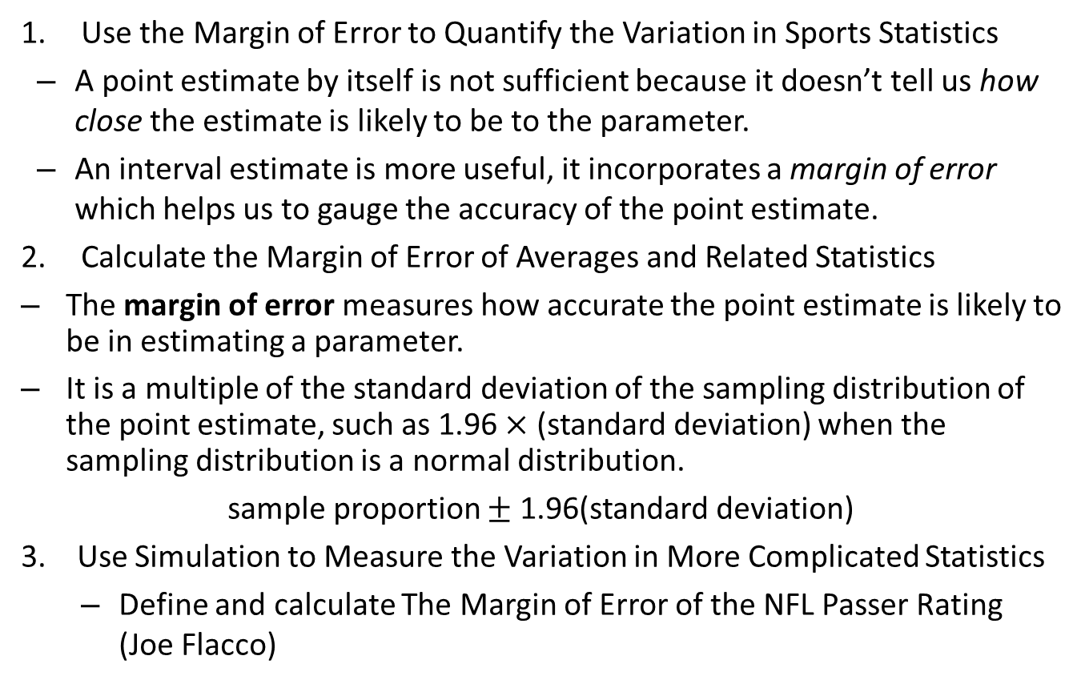
Chapter 4 Student Learning Objectives
Use the Margin of Error to Quantify the Variation in Sports Statistics
A point estimate by itself is not sufficient because it doesn’t tell us how close the estimate is likely to be to the parameter.
An interval estimate is more useful, it incorporates a margin of error which helps us to gauge the accuracy of the point estimate.
Calculate the Margin of Error of Averages and Related Statistics
The margin of error measures how accurate the point estimate is likely to be in estimating a parameter.
It is a multiple of the standard deviation of the sampling distribution of the point estimate, such as 1.96 $×$ (standard deviation) when the sampling distribution is a normal distribution.
sample proportion $±$ 1.96(standard deviation)
3. Use Simulation to Measure the Variation in More Complicated Statistics
Define and calculate The Margin of Error of the NFL Passer Rating (Joe Flacco)

Slide 10
Chapter 4 Student Learning Objectives
Understand Statistical Significance
Correlation coefficient |r| > 0 implied a relationship
Hypothesis tests with H₀ = no effect
Confidence Intervals (that didn’t include 0)
Be able to Compare the American and National Leagues
Designated Hitters
Pitchers throwing Home Runs
Understand the Margin of Error and how it is applied to Adjusted Statistics (like Slugging Average)
Adjusted Stats commonly use ‘weighted sums’ whose percentages affect the MEs
Learn and use the Computational capabilities of Excel and StatCrunch needed in this chapter.

Slide 11
Chapter 5 Student Learning Objectives
Use Correlation to Detect Statistical Relationships
Strong positive and negative linear relationships
Correlation coefficient |r| > 0 implied a relationship
Recognize and be able to define Linear Relationships:
Y-hat prediction of independent variable x
(Y – Y-hat) A residual is the vertical distance between a data point and the regression line. Each data point has one residual. They are positive if they are above the regression line and negative if they are below the regression line. ... In other words, the residual is the error that isn't explained by the regression line
That is, the value of Y is made up of two components:
a “systematic” component a + bX, which is a linear function of the corresponding value of X, and
random error.
Recognize and be able to describe how to Remove the Effect of a Lurking Variable
Re-do the analysis without it (not sophisticated but effective)

Slide 12
Chapter 5 Student Learning Objectives
Be able to answer What Does Nadal Do Better on Clay?
Win – by using Hypothesis test and Confidence Interval
Recognize the Caution of Using Team-Level Data
Not the same players year after year
Learn and use the Computational capabilities of Excel and StatCrunch needed in this chapter.

Slide 13
Chapter 6 Student Learning Objectives
Be able to model the Relationship between Two Variables Using Simple Linear Regression
With Excel Scatter Diagrams and trendlines
Recognize The Relationship between Wins Above Replacement and Team Wins
Remember WAR is a measure of a player’s contribution to his/her team’s wins
This didn’t stop Prof Severeni from doing a Regression analysis of WAR – using FanGraphs's definition of WAR
Understand and be able to express the meaning of Regression to the Mean: Why the Best Tend to Get Worse and the Worst Tend to Get Better
Regression to the Mean - Y’s vary more than X’s
Be able to Detect Clutch Hitting
Does clutch hitting even exist?

Slide 14
Chapter 6 Student Learning Objectives
Be able to answer Do NFL Coaches Expire? A Case of Missing Data
Didn’t do this one in class
When did we recognize ‘missing data’?
Designated Hitter
Serena Williams
Understand Using Polynomial, Quadratic, Exponential and Logarithmic Regression to Model Nonlinear Relationships
Griffey’s home run rate by year(age).
Points per game versus average TOI for NHL forwards.
PASSING AND SCORING IN THE ENGLISH PREMIER LEAGUE
Understand The Issue to Be Aware of When Using Multiyear Data
This type of situation is not uncommon whenever the dataset consists of players or teams measured several times over the course of several seasons.
In those cases, we do not expect the assumption that the error terms are completely random to be literally true.
Fortunately, even if this assumption is not satisfied, the estimates obtained in the linear regression analysis are still valid descriptions of the relationships in the data.
Learn and use the Computational capabilities of Excel and StatCrunch needed in this chapter.

